Slide 1
Government in the market
EC224 Lecture 6
Rob Hayward
Reading: Chapters 8 & 9 of Mankiw and Taylor

Slide 2
Learning Outcomes
The ability to understand and apply the following
Price controls and their effects on the market
The effects of specific and ad valorem taxes
The Tax incidence
How taxes affect welfare and the deadweight loss of taxation
Notions of efficiency and equity in design of the tax system

Slide 3
Price controls
Prcie ceilings and price floors

Slide 4
Supply, Demand, and Government Policies
In a free, unregulated market system, market forces establish equilibrium prices and quantities exchanged.
While equilibrium conditions may be efficient, it may be true that not everyone is satisfied.
One of the roles of economists is to use their theories to assist in the development of policies.
Notes:
2
2

Slide 5
Price controls
Are usually enacted when policymakers believe the market price is unfair to buyers or sellers.
Price Ceiling: A legal maximum on the price at which a good can be sold.
Price Floor: A legal minimum on the price at which a good can be sold.
Notes:
3
3

Slide 6
What is the effect of a price ceiling set above the equilibrium price?
Price of flats per sq m
Supply
€40
Price
ceiling
€30
Equilibrium
price
Demand
0
5 000
Quantity of rental accommodation
(000 sq m)
Equilibrium
quantity

Slide 7
What is the effect of a price ceiling set below the equilibrium price?
Price of flats per sq m
Supply
Equilibrium
price
€30
€20
Price
ceiling
Demand
0
Quantity of rental accommodation
(000 sq m)
Copyright©2014 Cengage

Slide 8
Effects of a binding price ceiling
A binding price ceiling stops prices adjusting to equilibrate demand and supply
Q_{D} > Q_{S} (shortages)
Example: Rent controls in New York restrict new building
Non-price rationing
Examples: first-come first served (long queues); discrimination by sellers
“Black markets”
Buyers willing to pay more and sellers wishing to charge more may seek each other out and transact illegally
Example: WW2 (rationing)
Notes:
14
11

Slide 9
What is the effect of a price floor set below the equilibrium price?
Price of alcohol per unit (€)
Supply
Equilibrium
price
€0.35
Price
floor
€0.25
Demand
0
5
Quantity of alcohol per unit (millions)
Equilibrium
quantity
Copyright©2014 Cengage

Slide 10
What is the effect of a price floor set above the equilibrium price?
Price of alcohol per unit (€)
Supply
€0.45
Price
floor
€0.35
Equilibrium
price
Demand
0
Quantity of alcohol per unit (millions)
Copyright©2014 Cengage

Slide 11
Effects of a binding price floor
A binding price floor stops prices adjusting to equilibrate demand and supply
Qs > Qd (surpluses)
Example: butter mountain
Black markets
Sellers that can turn a profit at a lower price and buyers willing only to pay a lower price may seek each other out and transact illegally
Notes:
24
15

Slide 12
Taxes
Types of taxes, tax incidence, and subsidies

Slide 13
TAXES
Why does a government levy taxes?
However
Taxes discourage market activity.
When a good is taxed, the quantity sold is smaller.
Buyers and sellers share the tax burden.
The tax incidence is the how the burden of a tax is distributed among buyers and sellers
Notes:
29
20

Slide 14
There are many different types of tax
A direct tax is levied on income and wealth
Indirect tax is levied on the sale of goods and services.
A specific tax is a set amount per unit of expenditure, for example, 58p per litre of petrol
An ad valorem tax (value added tax) is charged as a percentage of the sale price, for example 20% VAT
Notes:
30
22

Slide 15
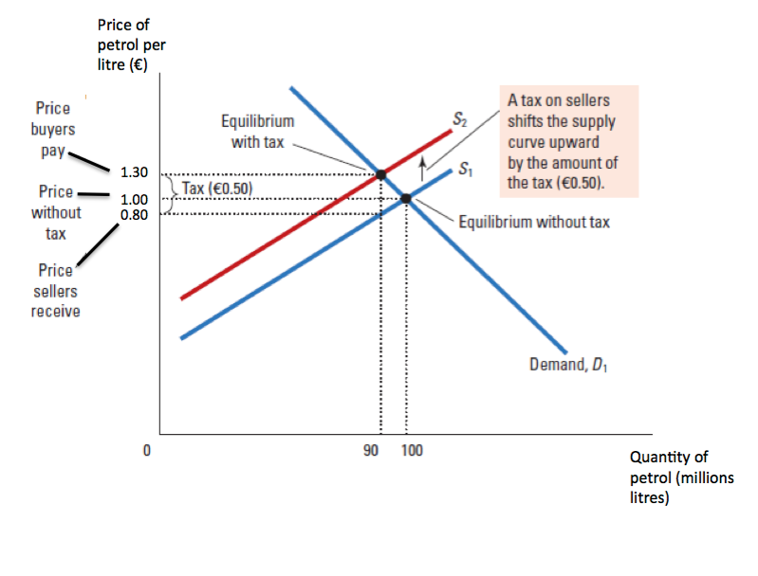
The Effects of a Specific Tax of €0.50
Copyright©2014 Cengage

Slide 16
Specific Tax
A Specific Tax where the government requires the seller to pay a certain amount for each good sold.
Supply curve shifts up by the amount of the tax.
Quantity sold falls.
Even though the tax is levied on sellers, buyers and sellers will share the burden of the tax; buyers pay more for the good and sellers receive less (because of the tax)
A tax on sellers places a wedge between the price buyers pay and the price sellers receive.
Notes:
31
21

Slide 17
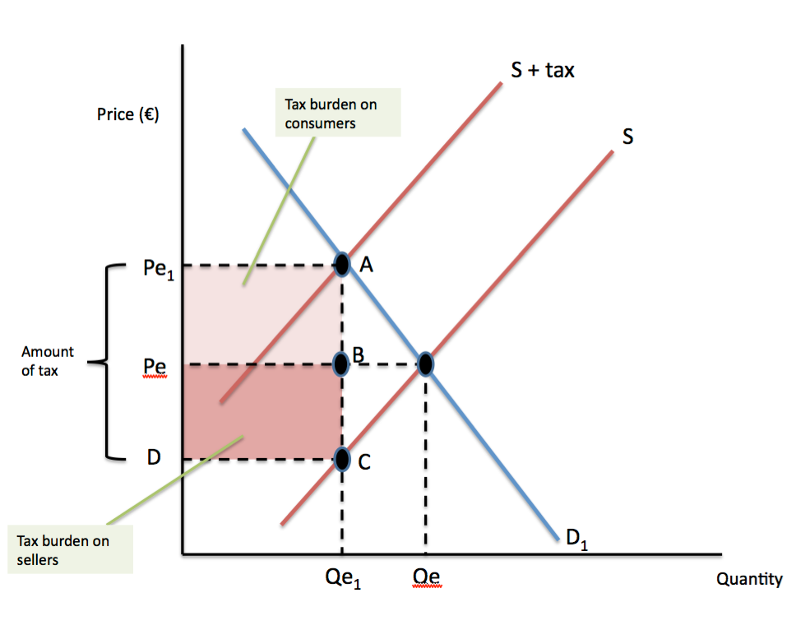
The Tax Incidence (The burden of the tax on buyers and sellers)
Copyright©2014 Cengage

Slide 18
Effects of an Ad Valorem Tax
An ad valorem tax on sellers.
Like the specific tax, the buyers and sellers will share the burden of the tax
Supply curve shifts up but not by a parallel amount.
For example if VAT is introduced at 20% then:
A product costing €20 means the seller pays €4 VAT.
A product costing €50 means the seller pays €10 VAT.
At low prices, the amount of the tax paid is relatively low but 20 per cent of higher prices means the seller has to give more to the government.
Notes:
31
21

Slide 19
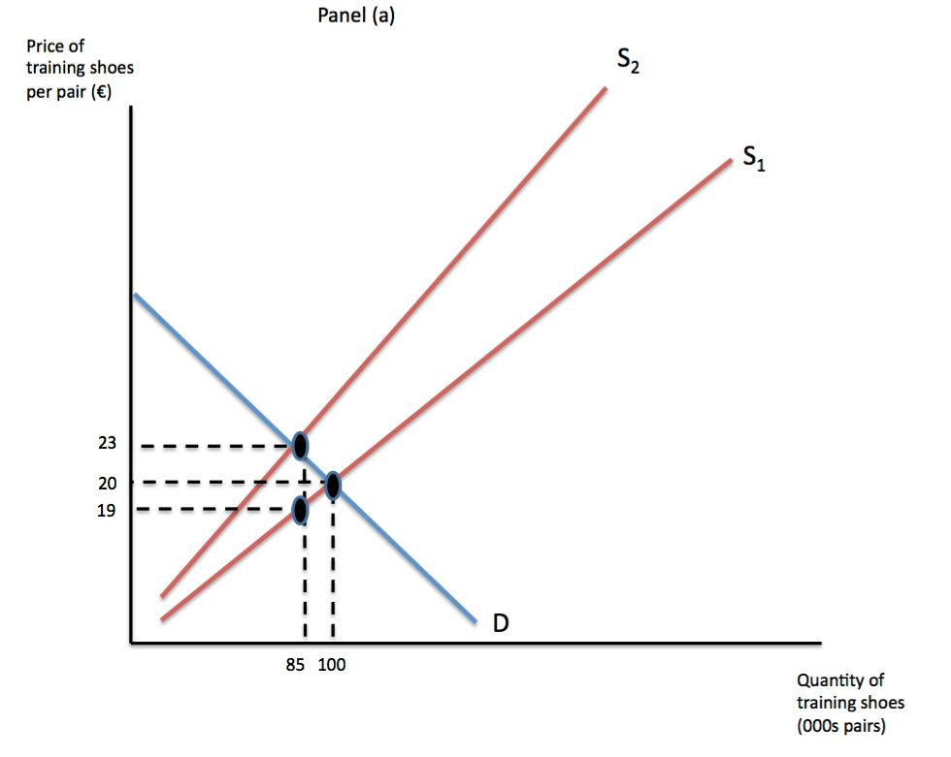
Effects of an Ad Valorem tax
When a tax of 20 per cent is levied on sellers, the supply curve shifts to the left from S₁ to S₂.
At low prices, the amount of the tax paid is relatively low
Copyright©2014 Cengage

Slide 20
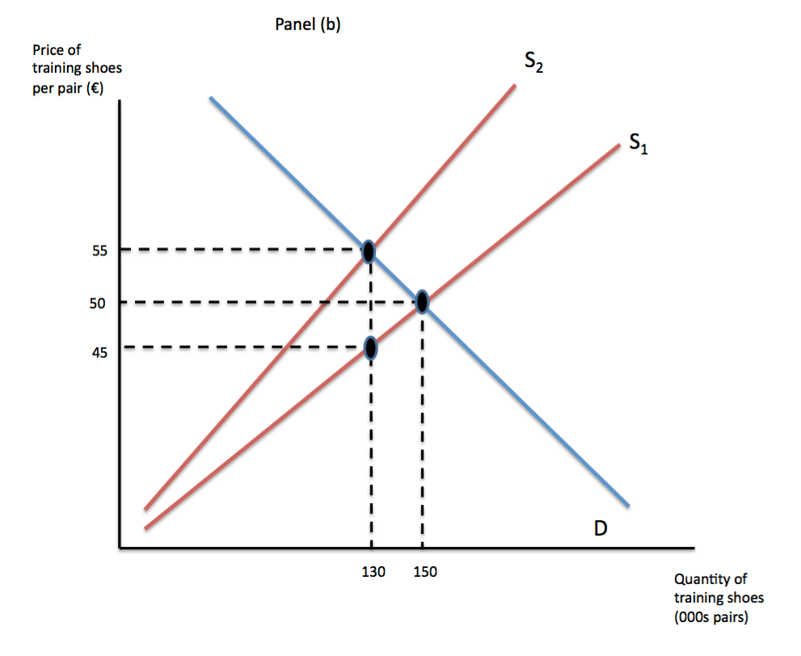
The Effects of an Ad Valorem tax
At higher prices the seller has to give more to the government.
Copyright©2014 Cengage

Slide 21
Price Elasticity and Tax Incidence
Taxes result in a change in market equilibrium. Taxes discourage market activity
Buyers pay more and sellers receive less, regardless of whom the tax is levied on. I.e. Buyers and sellers share the tax burden.
Exactly how the burden of tax is split – the tax incidence – is determined by the relative elasticities of the demand and supply curves.
Notes:
31
21

Slide 22
Exercise
On the next two slides identify how the burden of tax is divided
Under what circumstances do sellers bare the most tax?
Under what circumstances do buyers bare the most tax?
Why?

Slide 23
How is the burden of tax divided?
(a) Price Elastic Supply, Price Inelastic Demand
Price
Price buyers pay
Supply
Tax
Price without tax
Price sellers
receive
Demand
0
Quantity
Copyright©2014 Cengage

Slide 24
How is the burden of tax divided?
(b) Price Inelastic Supply, Price Elastic Demand
Price
Price buyers pay
Supply
Price without tax
Tax
Price sellers
Demand
receive
0
Quantity
Copyright©2014 Cengage

Slide 25
Subsidies
A subsidy is the opposite to a tax.
A subsidy is a payment to buyers and sellers to supplement income or lower costs and which thus encourages consumption or provides an advantage to the recipient.
Notes:
30
22

Slide 26
How Subsidies Affect Markets
Using rail travel as an example, subsidies:
Alter the incentives for people to travel on the train rather than on the roads.
Reduces congestion
Reduces pollution
A subsidy is given to railway companies shifts the supply curve outwards and lowers the price to buyers and so increases the amount purchased.
Both buyers and suppliers share the benefit of the subsidy.
So, is everyone a winner? What are the costs?
Notes:
30
22

Slide 27
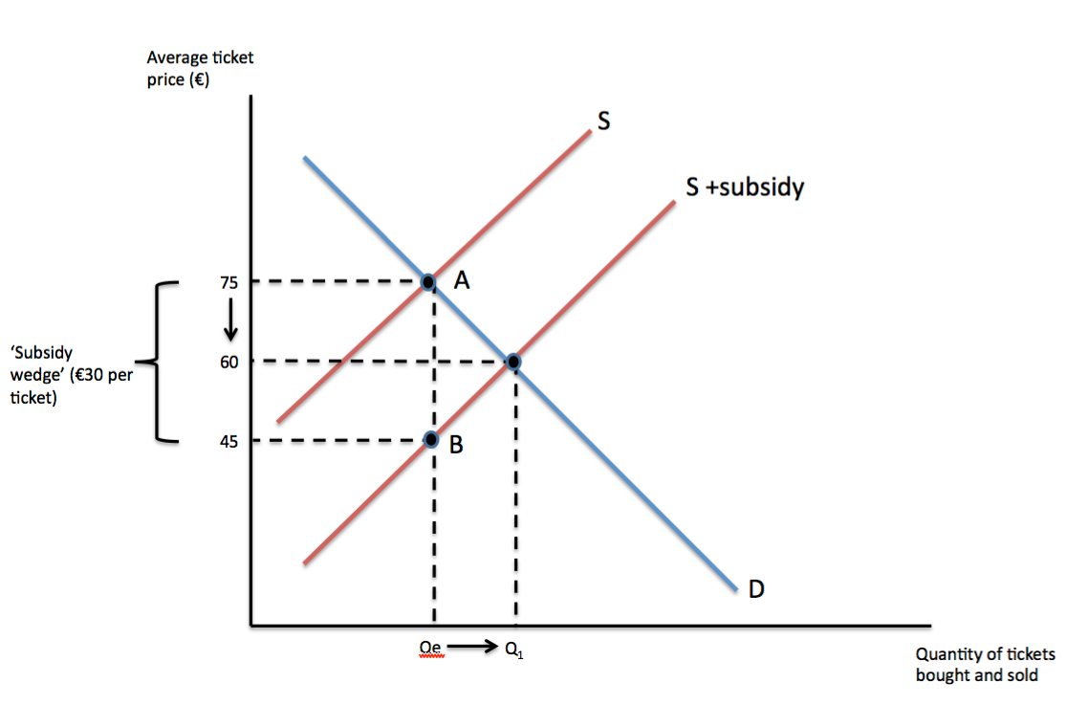
A subsidy to railway companies
Copyright©2014 Cengage

Slide 28
Summary
Price controls include price ceilings and price floors.
A price ceiling is a legal maximum on the price of a good or service. An example is rent control.
A price floor is a legal minimum on the price of a good or a service. An example is the minimum wage.
Taxes are used to raise revenue for public purposes and/or changing behaviour
When the government levies a tax on a good, the equilibrium quantity of the good falls.

Slide 29
Summary
A tax on a good places a wedge between the price paid by buyers and the price received by sellers.
The incidence of a tax refers to who bears the burden of a tax.
The incidence of the tax depends on the price elasticities of supply and demand.
The burden tends to fall on the side of the market that is less price elastic.
The incidence of a tax does not depend on whether the tax is levied on buyers or sellers.

Slide 30
Summary
Subsidies are the opposite to taxes.
Subsidies to sellers shift the supply curve to the right, lowers price to buyers and increases the amount purchased.
Both suppliers and buyers gain from subsidies.
Subsidies cost money, usually the taxpayer

Slide 31
Taxes and Efficiency
Deadweight loss, equity and efficiency

Slide 32
TAXES AND EFFICIENCY
Governments raise taxes to:
help pay for the various services that government provides.
influence behaviour and achieve market outcomes that are deemed desirable.
Two objectives when designing a tax system are efficiency and equity.
One tax system is more efficient than another if it raises the same amount of revenue at a smaller cost to taxpayers and the government.
When is one tax system fairer than another?

Slide 33
TAXES AND EFFICIENCY
Efficient taxes have small deadweight losses and low administrative burdens.
Deadweight loss is the fall in total surplus that results from a market distortion, such as a tax.

Slide 34
THE DEADWEIGHT LOSS OF TAXATION
It does not matter who a tax is levied on; buyers and sellers will share in the burden of the tax.
A tax on a product means:
The price that a buyer pays will be greater than the price the seller receives.
Therefore there is a tax wedge between the two prices.
The quantity sold will be smaller if there was no tax.

Slide 35
The Effects of a Tax
Price
Supply
Price buyers
Size of tax
pay
Price
without tax
Price sellers
receive
Demand
0
Quantity
Quantity
Quantity
with tax
without tax
Copyright©2014 Cengage

Slide 36
How a Tax Affects Market Participants
Tax Revenue
T = the size of the tax
Q = the quantity of the good sold
T × Q = the government’s tax revenue

Slide 37
Tax Revenue
Price
Supply
Price buyers
Size of tax (T)
pay
Tax
revenue
(T × Q)
Price sellers
receive
Quantity
Demand
sold (Q)
0
Quantity
Quantity
Quantity
with tax
without tax
Copyright©2014 Cengage

Slide 38
How a Tax Effects Welfare
Price
Price
A
Supply
buyers
=
PB
pay
B
Price
C
without tax
=
P1
D
E
Price
sellers
=
PS
receive
F
Demand
0
Q2
Q1
Quantity
Copyright©2014 Cengage

Slide 39
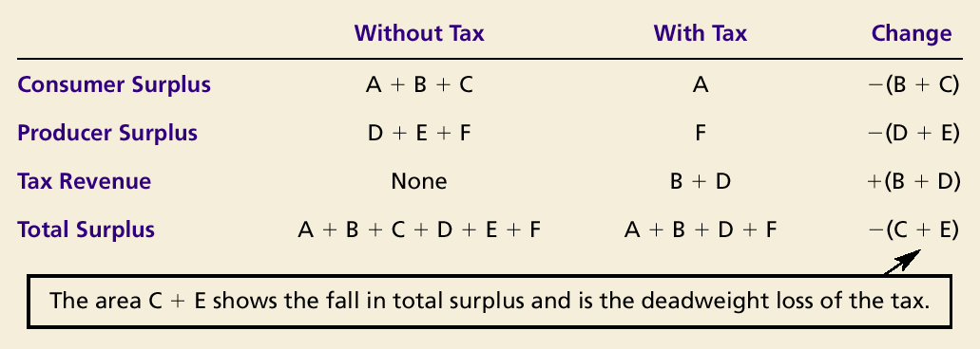
How a Tax Affects Market Participants

Slide 40
How a Tax Affects Market Participants
The change in total welfare includes:
The change in consumer surplus,
The change in producer surplus, and
The change in tax revenue.
The losses to buyers and sellers exceed the revenue raised by the government.
This fall in total surplus is called the deadweight loss.
Taxes cause deadweight losses because they prevent buyers and sellers from realizing some of the gains from trade.

Slide 41
The Deadweight Loss
Price
Lost gains
Supply
from trade
PB
Size of tax
Price
without tax
PS
Cost to
sellers
Demand
Value to
buyers
0
Q₂
Q₁
Quantity
Reduction in quantity due to the tax
Copyright©2014 Cengage

Slide 42
DETERMINANTS OF THE DEADWEIGHT LOSS
What determines whether the deadweight loss from a tax is large or small?
The magnitude of the deadweight loss depends on how much the quantity supplied and quantity demanded respond to changes in the price.
That, in turn, depends on the price elasticities of supply and demand.

Slide 43
Tax Distortions and Price Elasticities
(a) Price Inelastic Supply
Price
Supply
When supply is
relatively price inelastic,
the deadweight loss
of a tax is small.
Size of tax
Demand
0
Quantity
Copyright©2014 Cengage

Slide 44
Tax Distortions and Price Elasticities
(b) Price Elastic Supply
Price
When supply is relatively
price elastic, the deadweight
loss of a tax is large.
Size
Supply
of
tax
Demand
0
Quantity
Copyright©2014 Cengage

Slide 45
Tax Distortions and Price Elasticities
(c) Price Inelastic Demand
Price
Supply
Size of tax
When demand is
relatively price inelastic,
the deadweight loss
of a tax is small.
Demand
0
Quantity
Copyright©2014 Cengage

Slide 46
Tax Distortions and Price Elasticities
(d) Price Elastic Demand
Price
Supply
Size
of
tax
Demand
When demand is relatively
price elastic, the deadweight
loss of a tax is large.
0
Quantity
Copyright©2014 Cengage

Slide 47
DEADWEIGHT LOSS AND TAX REVENUE AS TAXES VARY
With each increase in the tax rate, the deadweight loss of the tax rises even more rapidly than the size of the tax.

Slide 48
Deadweight Loss and Tax Revenue from Three Taxes of Different Sizes
(a) Small Tax
Price
Deadweight
loss
Supply
P_{B}
Tax revenue
P_{S}
Demand
0
Q₂
Q₁
Quantity
Copyright©2014 Cengage

Slide 49
Deadweight Loss and Tax Revenue from Three Taxes of Different Sizes
(b) Medium Tax
Price
Deadweight
P_{B}
loss
Supply
Tax revenue
P_{S}
Demand
0
Q₂
Q₁
Quantity
Copyright©2014 Cengage

Slide 50
Deadweight Loss and Tax Revenue from Three Taxes of Different Sizes
(c) Large Tax
Price
P_{B}
Deadweight
loss
Supply
Tax revenue
Demand
P_{S}
0
Q₂
Q₁
Quantity
Copyright©2014 Cengage

Slide 51
As taxes increase, the deadweight loss from the tax increases
For the small tax, tax revenue is small.
As the size of the tax rises, tax revenue grows.
But as the size of the tax continues to rise, tax revenue falls because the higher tax reduces the size of the market.

Slide 52
How Deadweight Loss and Tax Revenue Vary with the Size of a Tax
(a) Deadweight Loss
Deadweight
Loss
0
Tax Size
Copyright©2014 Cengage

Slide 53
How Deadweight Loss and Tax Revenue Vary with the Size of a Tax
(b) Revenue (the Laffer curve)
Tax
Revenue
0
Tax Size
Copyright©2014 Cengage

Slide 54
ADMINISTRATIVE BURDEN
Complying with tax laws creates additional deadweight losses.
Taxpayers spend time and money documenting, computing, and filling tax forms.
These are additional administrative costs they incur, over and above the actual taxes they pay.
The administrative burden of any tax system is part of the inefficiency it creates.

Slide 55
THE DESIGN OF THE TAX SYSTEM Adam Smith’s Four Canons of Taxation
Equality
Certainty
Convenience
Economic

Slide 56
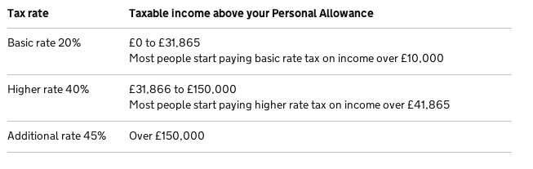
Marginal Tax Rates versus Average Tax Rates
The average tax rate is total tax paid divided by total income.
Measures the sacrifice made by a taxpayer
The marginal tax rate is the extra tax paid on an additional pound of income.
E.g. UK income tax rates 2014:

Slide 57
Lump-Sum Taxes
A lump-sum tax is a tax that is the same amount for every person, regardless of earnings or any actions that the person might take.
For this type of tax, the marginal tax rate is equal to zero.
This is the most efficient type of tax.
It does not distort incentives
Little administrative burden

Slide 58
TAXES AND EFFICIENCY
One tax system is more efficient than another if it raises the same amount of revenue at a lower cost to taxpayers.
An efficient tax system is one that imposes small deadweight losses and low administrative costs.

Slide 59
TAXES AND EFFICIENCY
The Cost of Taxes to Taxpayers
The tax payment itself
Deadweight losses
Administrative burdens

Slide 60
TAXES AND EQUITY
Principles of Taxation
Benefits principle
Ability-to-pay principle

Slide 61
Benefits Principle
The benefits principle is the idea that people should pay taxes based on the benefits they receive from government services.
A possible example is a tax on petrol:
Tax revenues from a tax on petrol could be used to finance our roads system.
People who drive the most would pay the most toward maintaining roads.

Slide 62
Ability-to-Pay Principle
The ability-to-pay principle is the idea that taxes should be levied on a person according to how well that person can shoulder the burden.
The ability-to-pay principle leads to two related notions of equity.
Vertical equity
Horizontal equity

Slide 63
Ability-to-Pay Principle
Vertical equity is the idea that taxpayers with a greater ability to pay taxes should pay larger amounts.
For example, people with higher incomes should pay more than people with lower incomes.

Slide 64
Ability-to-Pay Principle
Vertical Equity and Alternative Tax Systems
A proportional tax is one for which high-income and low-income taxpayers pay the same fraction of income.
A regressive tax is one for which high-income taxpayers pay a smaller fraction of their income than do low-income taxpayers.
A progressive tax is one for which high-income taxpayers pay a larger fraction of their income than do low-income taxpayers.

Slide 65
Ability-to-Pay Principle
Horizontal Equity
Horizontal equity is the idea that taxpayers with similar abilities to pay taxes should pay the same amounts.
For example, two families with the same number of dependents and the same income living in different parts of the country should pay the same amount of tax.

Slide 66
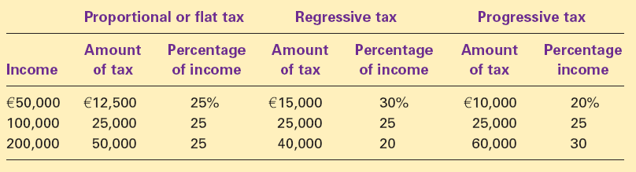
Three Tax Systems
Copyright©2014 Cengage Learning

Slide 67
Tax Incidence and Tax Equity
The difficulty in formulating tax policy is balancing the often conflicting goals of efficiency and equity.
The study of who bears the burden of taxes Tax incidence) is central to evaluating tax equity.
Corporation tax may be popular among voters.
The workers, customers and shareholders of a corporation actually bear the burden of corporation tax.
There are consequences of increasing corporation tax.

Slide 68
Summary
A tax on a good reduces the welfare of buyers and sellers of the good, and the reduction in consumer and producer surplus usually exceeds the revenues raised by the government.
The fall in total surplus—the sum of consumer surplus, producer surplus, and tax revenue — is called the deadweight loss of the tax.
Taxes have a deadweight loss because they cause buyers to consume less and sellers to produce less.
This change in behavior shrinks the size of the market below the level that maximizes total surplus.

Slide 69
Summary
As a tax grows larger, it distorts incentives more, and its deadweight loss grows larger.
Tax revenue first rises with the size of a tax.
Eventually, however, a larger tax reduces tax revenue because it reduces the size of the market.
Equity and efficiency are two important goals of the tax system.
The efficiency of a tax system refers to the costs it imposes on the taxpayers.

Slide 70
Summary
The equity of a tax system concerns whether the tax burden is distributed fairly among the population.
According to the benefits principle, it is fair for people to pay taxes based on the benefits they receive from the government.
According to the ability-to-pay principle, it is fair for people to pay taxes on their capability to handle the financial burden.
Much of the debate over tax policy arises because people give different weights to the two goals of efficiency and equity.

